Slide 1
Errands for Seniors
Done by: Matthew, Luke, Junwei, winston

Slide 2
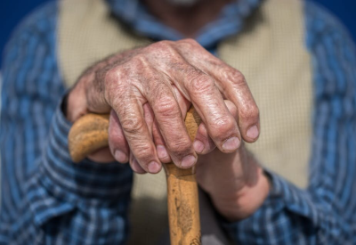
Problem Seniors Face
Research shows that at least 250,000 seniors are in need of care, from various sources.
And close to 50% of seniors don't have access to 2 of 4 major domains.
Notes:
An elderly requires $1.4k monthly, and 6.6% lives alone, 15.2% population is 65 and above, 5.6% elderly population growth, 4.3 old age support ratio(working to non working), with the GDP of singaporeans being over 65k in 2019
elderly have needs. must have stats(x amount of seniors don't have their needs met)
While the SSS only provides up to $1350 quarterly. Other than medical benefits, the elderly who do not work, have no chance of surviving off this payout.(Silver Support Schemes)
sth% of elderly doesn't have access to sth, make it emotional as possible.
Unmet care needs seem to occur largely in informational (30%–55%), psychological (18%–42%), physical (17%–48%) and functional (17%–37%) domains

Slide 3
Solution: Errands for seniors
An app targeted at helping seniors who requires aid with their general needs.
Users will be able to help elderly with simple tasks such as:
--Buying groceries for them, tidy up their house, clearing the trash.
Volunteers can sign up to help the seniors in the app.

Slide 4
The Opportunity
The Silver Support Scheme services only helps to alleviate the problem it does not solve it.
Not all elderly qualifies for the Silver Support Scheme service.
Most Service app targets the general population and not just the elderly.

Slide 5
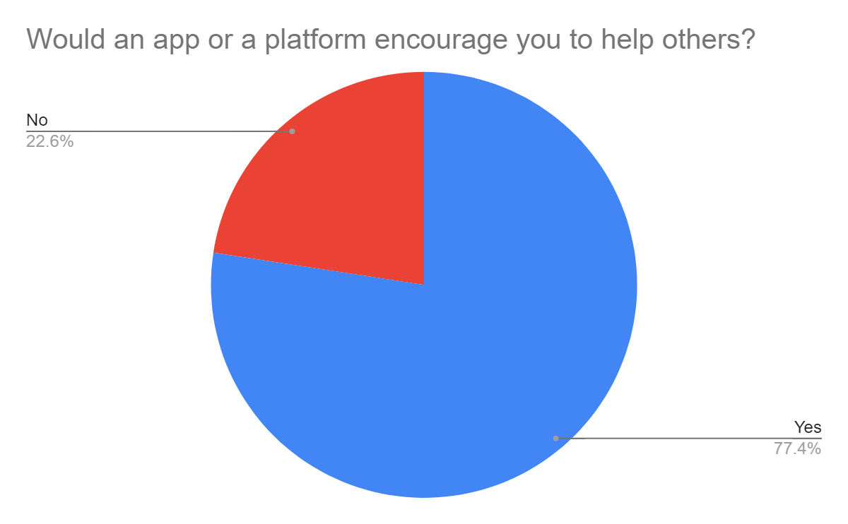
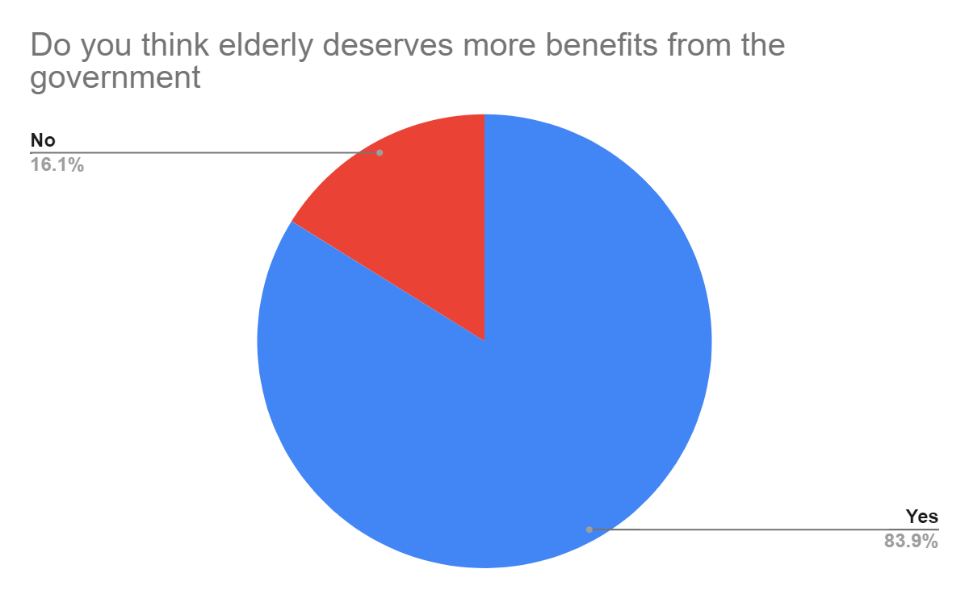
Survey Results
77.4% people are more likely to help others when presented with an app or a platform.
83.9% people think that elderly deserves more benefits from the government.
94.4% of the responses include elderlies struggling with basic tasks in one way or another.

Slide 6
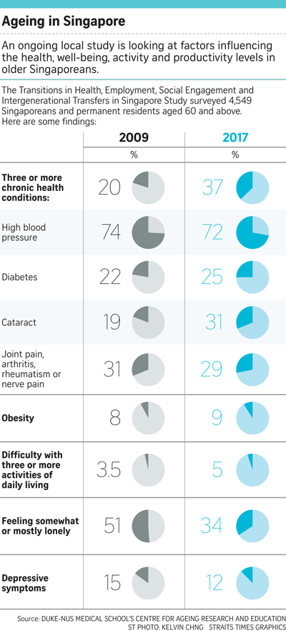
Market Size & Revenue Approximation
One in four Singaporeans will be 65 and older by 2030
29% of elderly in 2017 experience joint pain, arthritis, rheumatism or nerve pain
31% of elderly in 2017 experience cataract
Global market for elder care assistive devices should grow from $705.8 billion in 2020 to $914.9 billion by 2025 at compound annual growth rate (CAGR) of 5.3% for the period of 2020-2025.
Uber processed $26.61 billion worth of bookings in 2020.

Slide 7
Revenue Based on Existing Data
Based on Ministry of Health, there are 10,000 home care places
5 units of service /senior /day at $5-10 /unit of service.
Assuming that we make $5 /service we can expect to make $25 a day /senior.
Assuming we have 10k and that every elderly needs 5 task per day.
We can roughly expect to generate $250k per year.
Notes:
MOH - 10,000 home care places by 2020, use it as our client base

Slide 8
Public Private Partnership
Secure a Operation & Maintenance contract with the government.
Funding from government will be used to maintain and operate the app.
Funds will be used to incentivise volunteers to help elderly.
Notes:
explain what would we do with funds)

Slide 9
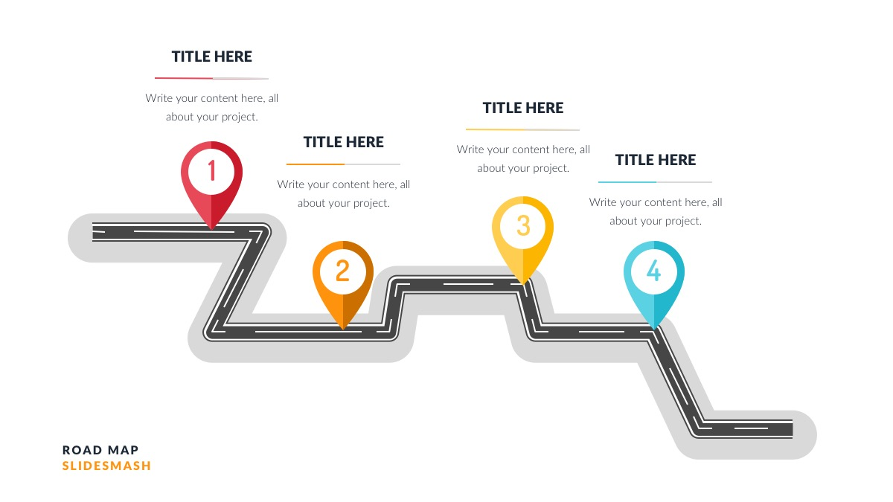
Roadmap
Setup Project
Q1: Setup and preparation of project
Q2: Start Development of App
Q3: Secure the Partnership
Q4: Release Platform
Secure Partnership
Plan where to allocate resources
Start Project
Launch Platform
Secure a contract with the government
Develop app
Release app to the public

Slide 10
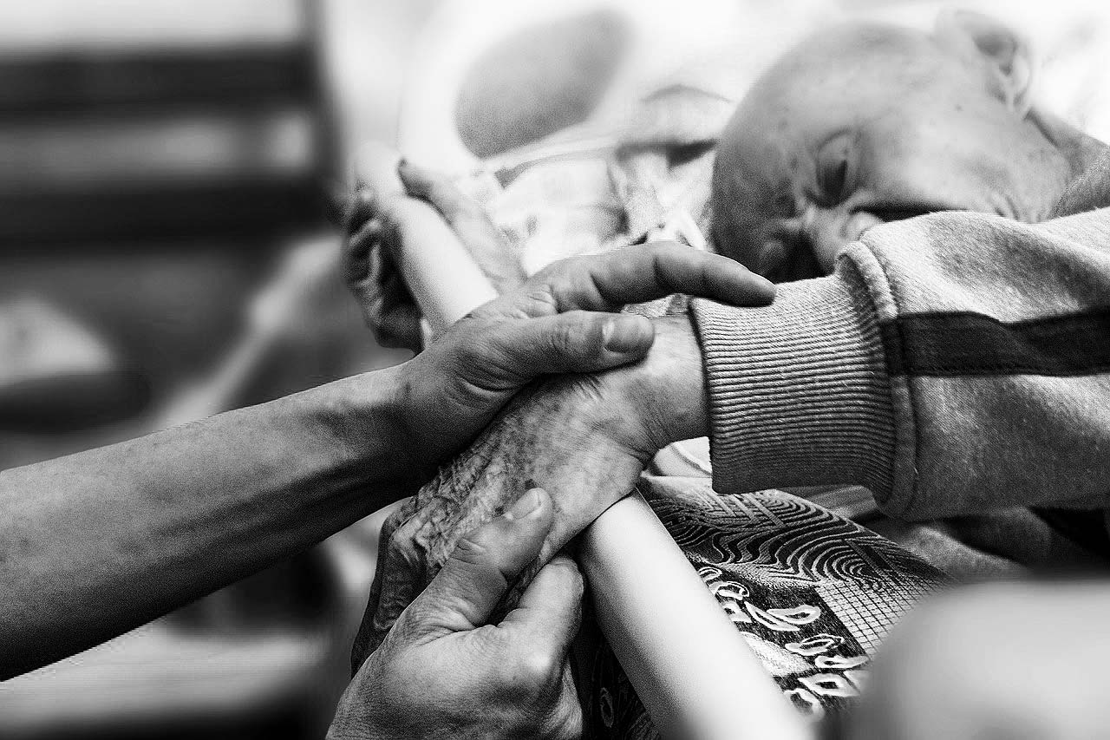
Conclusion
“To forget the elderly is to forget the wisdom of the years”
Donald Laird

Slide 11
Sources and links:
Slide 3 - Rallis, C. (B. (2020, May 20). 'Anti-ageing' protein shown to slow cell growth is key in longevity – new research. Phys.org. https://phys.org/news/2020-05-anti-ageing-protein-shown-cell-growth.html.
Slide 5 - Hirschmann, R. (2020, December 8). Topic: Aging population of Singapore. Statista. https://www.statista.com/topics/5821/ageing-population-of-singapore/.
Slide 6 - https://docs.google.com/forms/d/1mh55xJeg0RFnwXRE5rMN9TEw-FL9XXvs1ha5RsOT72Y/edit?usp=sharing
Slide 7 - Choo, F. (2019, May 8). Proportion of Older Adults with Multiple Chronic Diseases Surges. https://www.sgh.com.sg/news/tomorrows-medicine/proportion-of-older-adults-with-multiple-chronic-diseases-surges.
Slide 7 - Iqbal, M. (2021, May 15). Uber Revenue and Usage Statistics (2021). Business of Apps. https://www.businessofapps.com/data/uber-statistics/.
Slide 11 - Hingorani, S. (2019, October 1). Burden of caring for ageing parents weighs heaviest on unmarried daughters: AWARE Singapore. AWARE. https://www.aware.org.sg/2019/10/burden-of-caring-for-ageing-parents-weighs-heaviest-on-unmarried-daughters/.

